Slide 1
Colorado Water Plan
Ethnie Treick & Nick Combs

Slide 2
Colorado Water Conservation Board’s guide for the future of water in Colorado. Considerations:
Colorado is warming
Demands are increasing
Water Conservation is critical
Storage is necessary
Legal Framework guides Local Solutions
Grassroots Project Implementation
Need to proactively manage risk

Slide 3
Strengths:
Overview of the complexity of the system statewide and in each basin
Review of ongoing actions & who the players are in the nine basin roundtables
How collaboration is occurring
Overarching message of everybody having a shared responsibility
Modeling efforts are extensive
Good specific area reference – agency actions are detailed

Slide 4
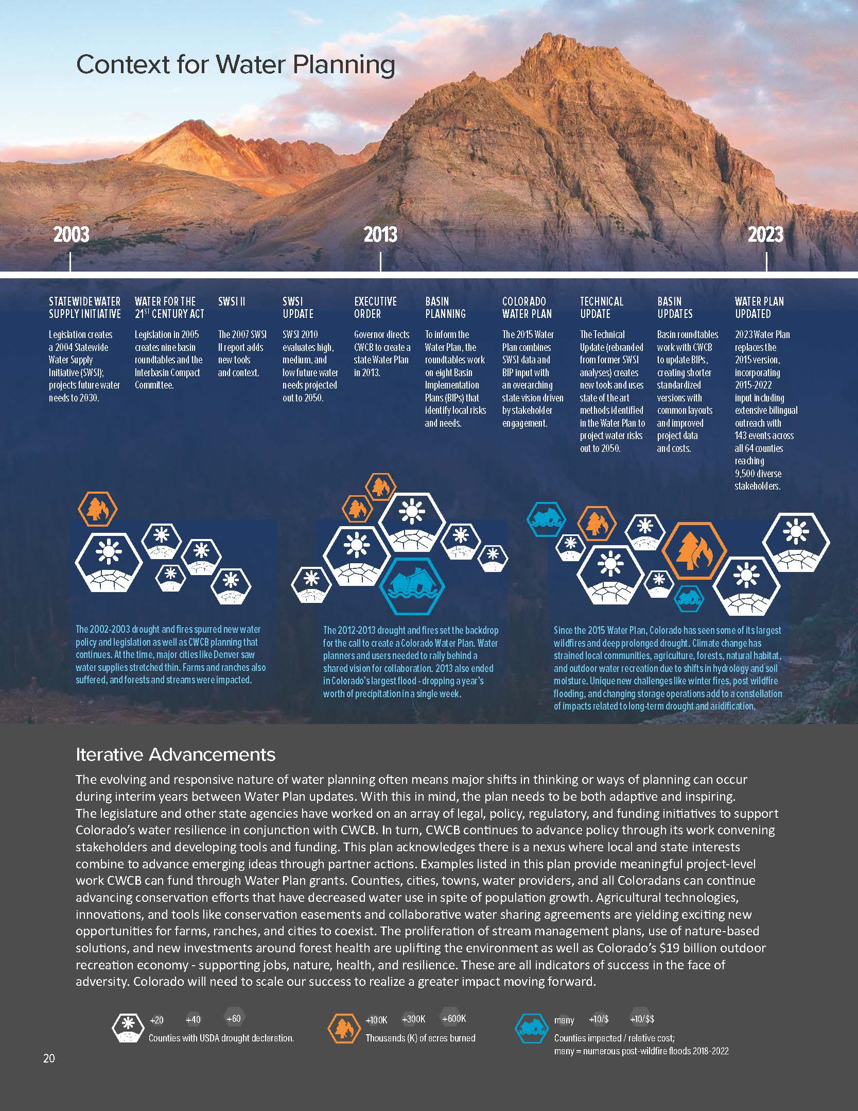
Challenges:
Local municipality & different basin interests
Need for more statewide collaboration
Buy & Dry is a bad thing
Diversity, Equity and Inclusion guiding principles developed/Water Equity Task Force
Only updated every 9 years
Making the plan more accessible (254 pages)

Slide 5
Closing Thoughts…Would We Recommend?
Good resource, reference point
Provides context for work underway and ways to get involved
Executive Summary gives good overview, read longer plan for more specifics
Online tool is useful

