Slide 1
Water Literate Leaders:
Water for Industry
April 10, 2024
Erik Nielsen
Associate General Counsel

Slide 2
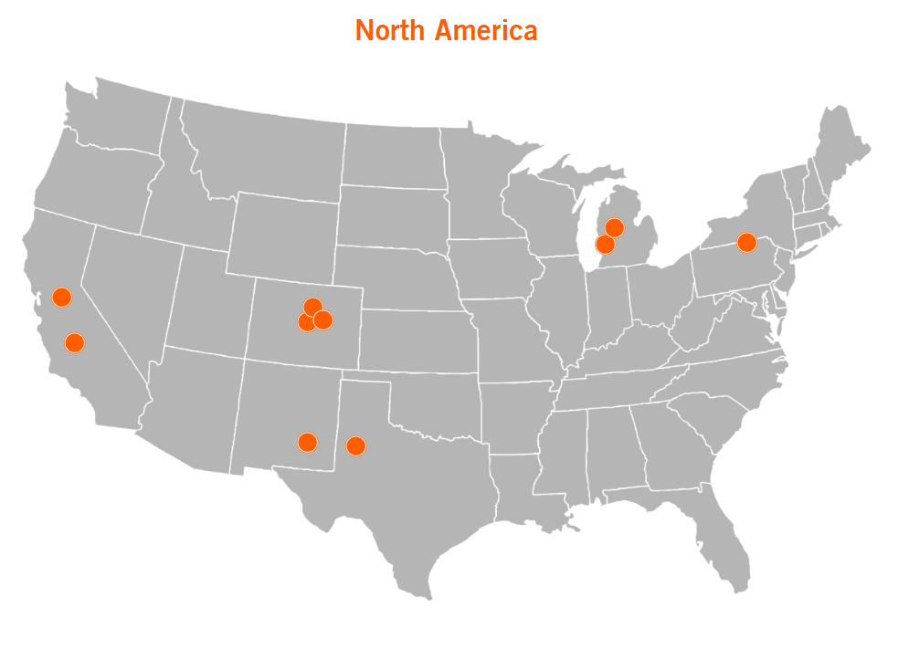
Our Global Footprint
We employ over 5,000 people worldwide
9 plants in the US (10th plant opening soon)

Slide 3
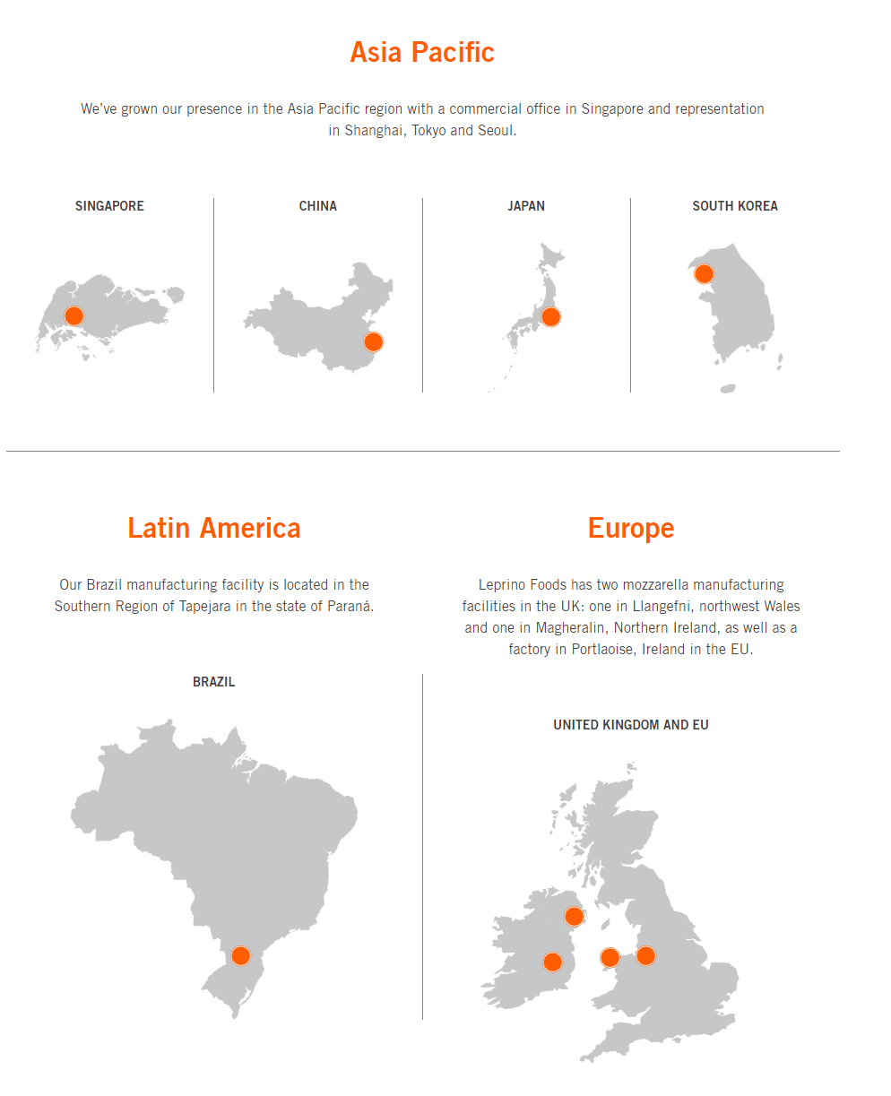
Leprino’s International Presence
Our products are found in 50+ countries
Manufacturing operations in Brazil, EU, and UK

Slide 4
It All Starts With Milk
Approximately 87% water
Remaining 13% is solids that we turn into products (Cheese, Whey Protein, Lactose)
Water portion captured and used for cleaning
Ultimately, water is treated and returned to the environment

Slide 5
PLAY Greeley Video
https://www.dropbox.com/s/fwj2u78do84om3s/Water%20in%20the%20West%20V4.mp4?dl=0

Slide 6
“Developed Water” Doctrine in Colorado
“To the extent that there exists a right to make a succession of uses of foreign, nontributary, or other developed water, such right is personal to the developer or his successors, lessees, contractees, or assigns. Such water, when released from the dominion of the user, becomes a part of the natural surface stream where released, subject to water rights on such stream in the order of their priority, but nothing in this subsection (2) shall affect the rights of the developer or his successors or assigns with respect to such foreign, nontributary, or developed water, nor shall dominion over such water be lost to the owner or user thereof by reason of use of a natural watercourse in the process of carrying such water to the place of its use or successive use.” Colo. Rev. Stat. § 37-82-106.
In a nutshell: if someone “develops” water from a non-traditional source in Colorado, the developer thereof has the right to use or sell that water, among other things, and can utilize natural watercourses to transport that water.

Slide 7
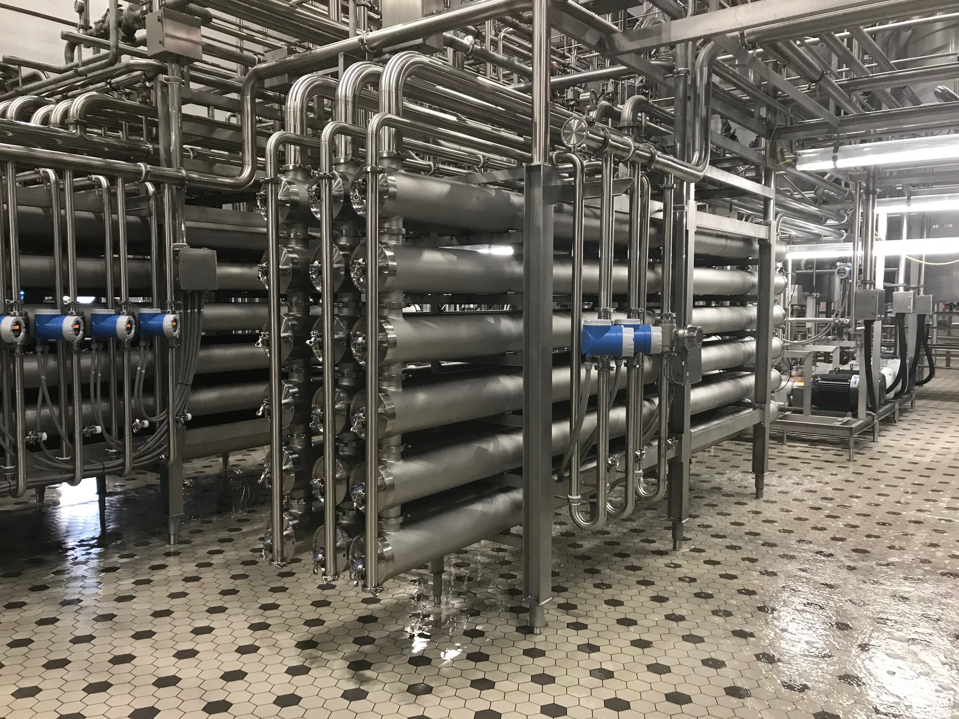
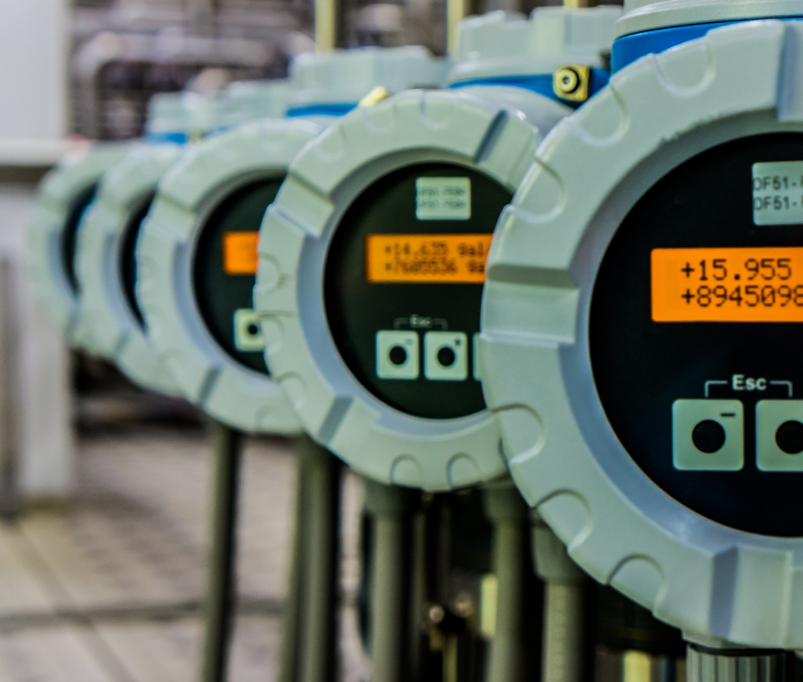
Other examples of water uses and conservation efforts
Water Metering

Slide 8
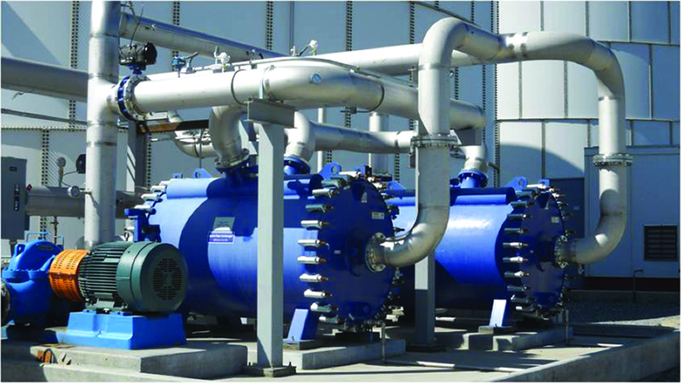
Other examples of water uses and conservation efforts
Wastewater Heat Recovery
Lemoore, California
Notes:
- This is a great example of an innovative project we completed in California. We consider all our utilities as key ingredients.
- Our plants use quite a bit of water for cleaning purposes.
- This water is relatively hot and must be treated before it can be discharged.
- Wasted heat=wasted energy= wasted $= unnecessary GHG emissions & fossil fuel consumption
- Wastewater can be as high as 120 degrees, use this heat in wastewater to heat incoming city water, which reduces energy needed to heat incoming water for cleaning purposes.
- Reduced energy costs of over $700k/year (= energy usage in 1200 homes/year)
- Additional benefit of higher quality wastewater because cooler water is easier to treat.
- The return on invested capital or ROIC (which I am sure all of the business students in the audience are focused in on) was just about 1 year.
- This means that by investing almost $1 million, we will save that same amount in energy costs in just over 1 year.
- Pretty impressive for a resource conservation project and just the type of environmental benefit- financial benefit win-wins we are looking for.

Slide 9
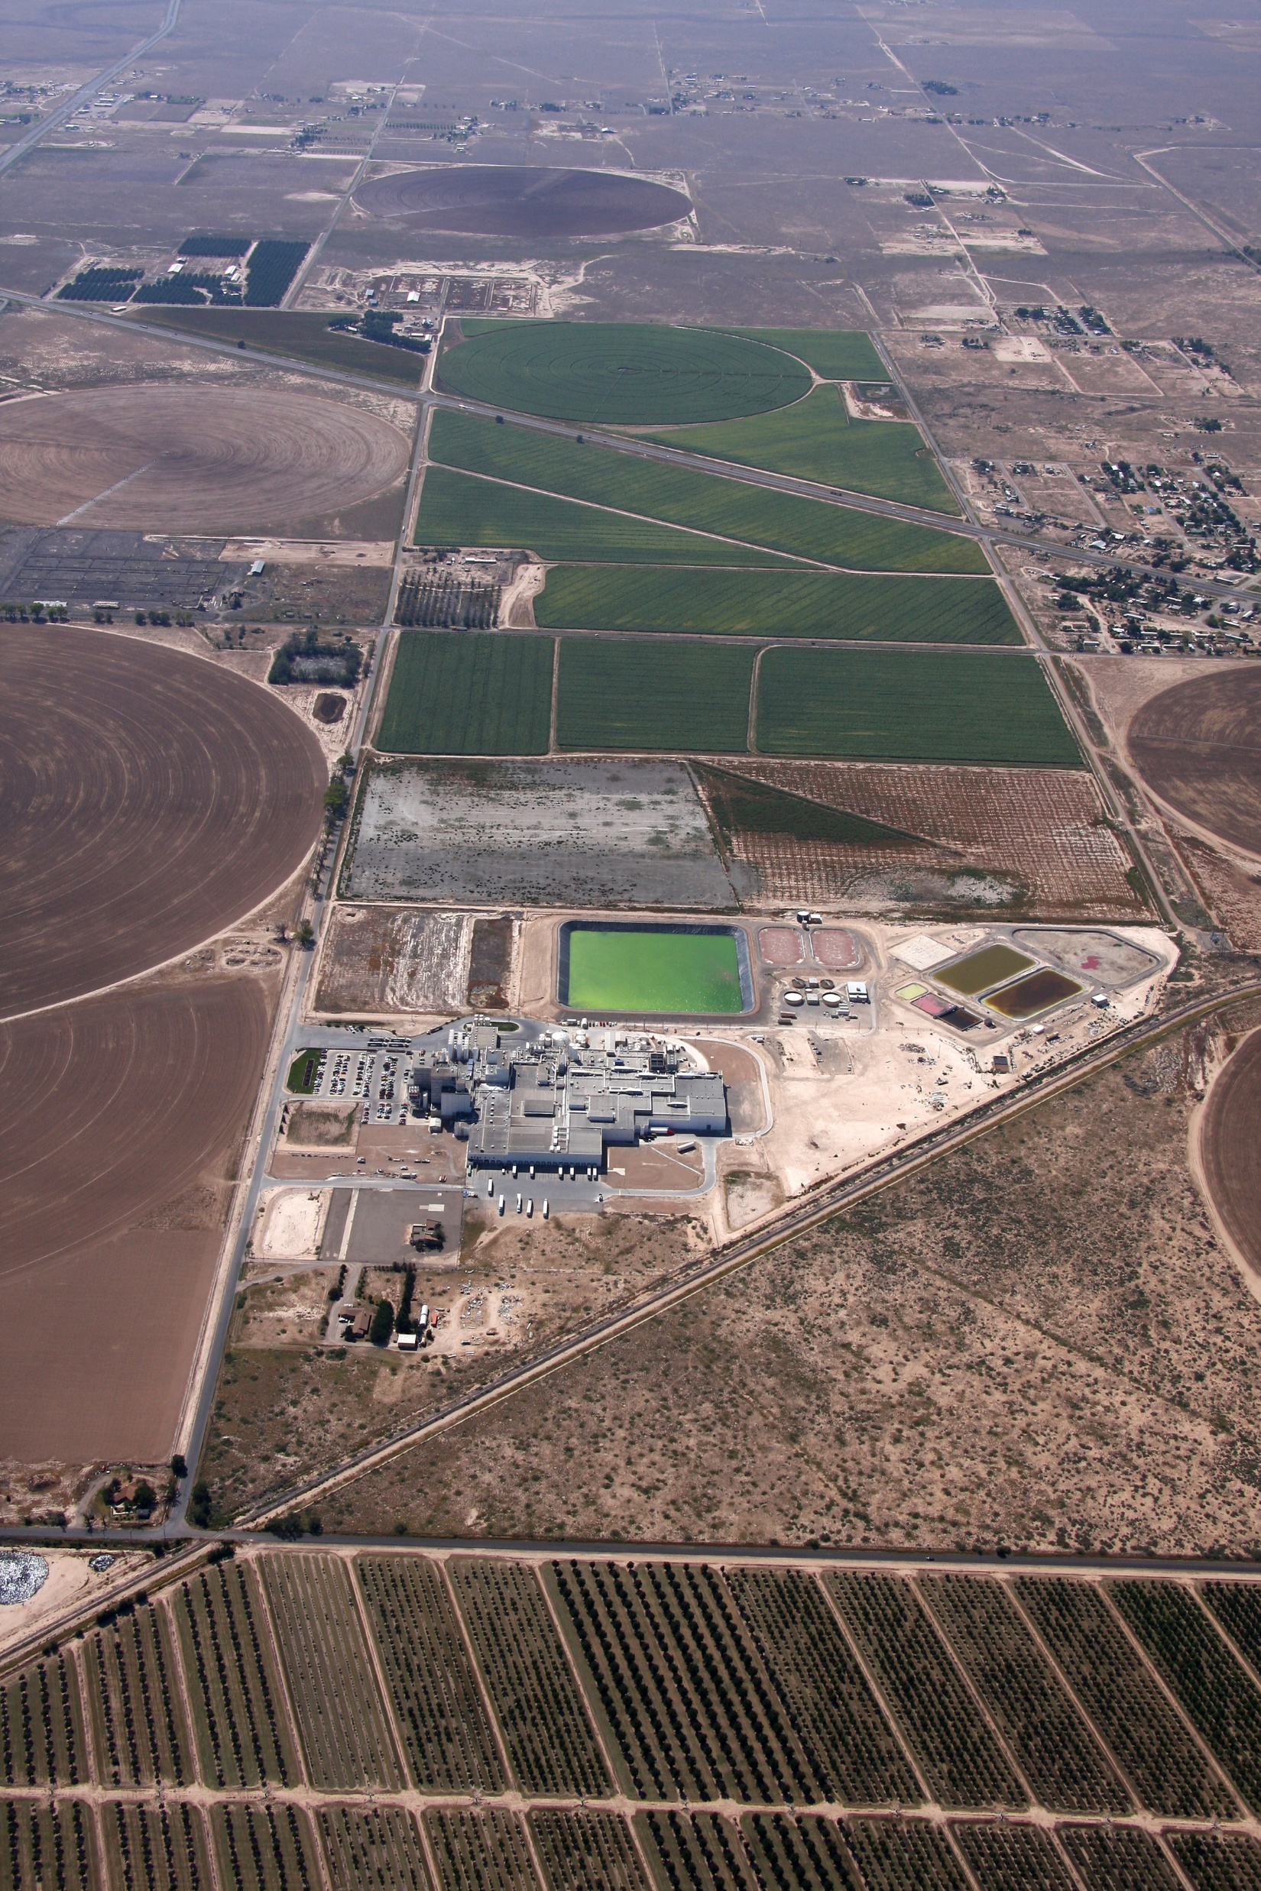
Other examples of water uses and conservation efforts
Water Cycle
Roswell, New Mexico

Slide 10
Zero Water?
Water Sources Today
Raw Water Supply
Plant
Operations
Treatment/Discharge to
Beneficial Use
Water from Milk

Slide 11
Zero Water Opportunity
Water Sources Today
X
Raw Water Supply
Plant
Operations
Water from Milk
^{Treatment}
Produced Water Reuse
Discharge to Beneficial Use

